Slide 1
RNA-seq and Gene Abundance Analysis
BIOCHEM 3BP3

Slide 2
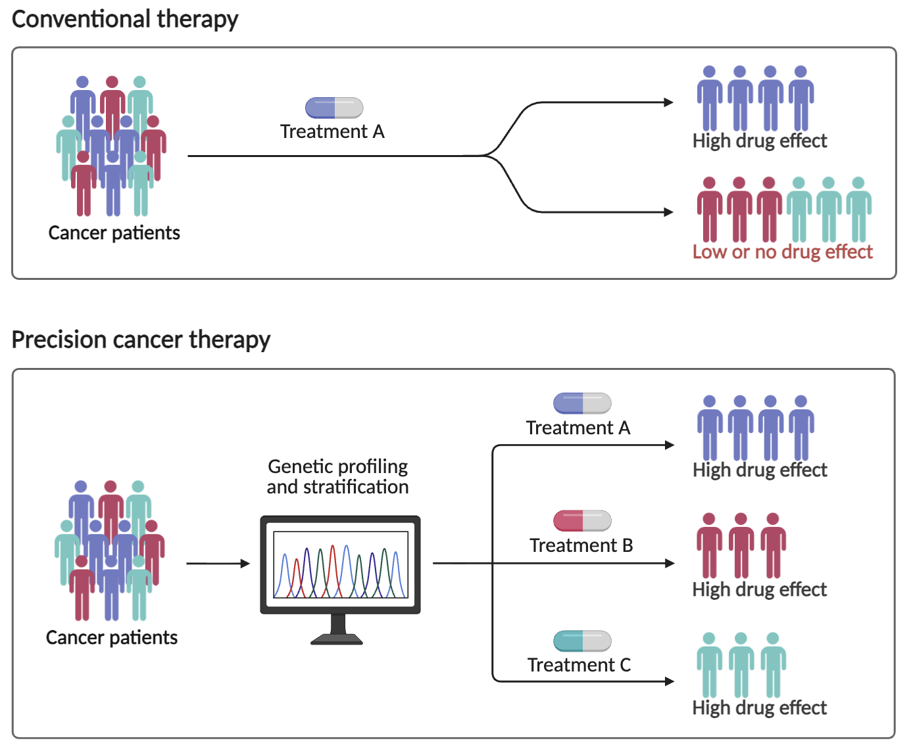
Motivation: personalized oncology
KRAS mutation
KRAS inhibitor
EGFR mutation
EGFR inhibitor
BRAF mutation
BRAF inhibitor
Biorender

Slide 3
Motivation: personalized oncology
?
Does the mutation increase or decrease the mRNA abundance of KRAS?
Novel KRAS mutation
KRAS inhibitor
Experimental design:
vs
Novel KRAS mutation (cases)
No KRAS mutation (controls)
Is there a significant difference in mRNA abundance of KRAS and the KRAS signaling pathway between cases and controls? RNA-sequencing
Biorender

Slide 4
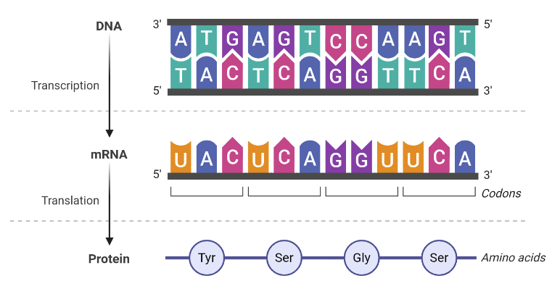
Central Dogma
Complete set of RNAs in a cell is called the “Transcriptome”
Biorender

Slide 5
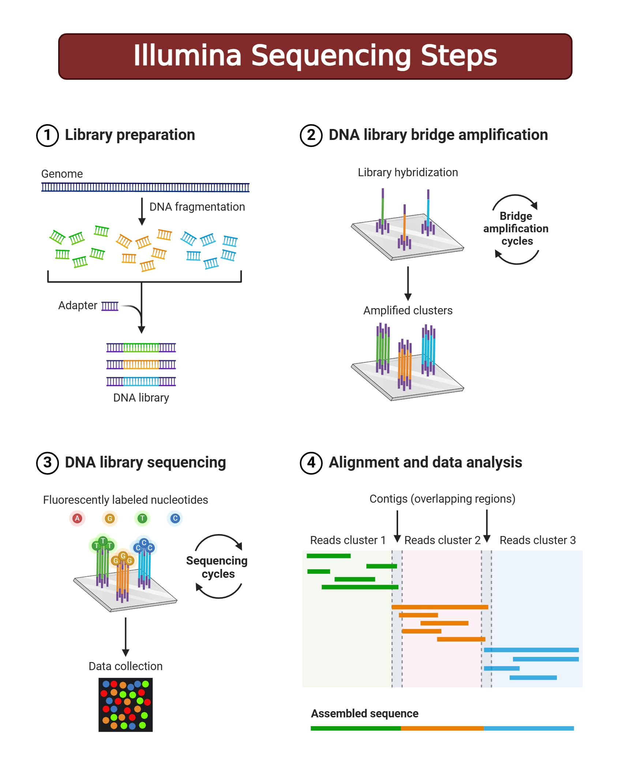
DNA sequencing: Illumina (short read sequencing)
RNA
DNA sequencing has an error rate, so a single pass is insufficient
Reads are ~250 bp before chemistry breaks down
https://microbenotes.com/illumina-sequencing/

Slide 6
DNA sequencing: Illumina (short read sequencing)
RNA
DNA sequencing has an error rate, so a single pass is insufficient
Reads are ~250 bp before chemistry breaks down
https://microbenotes.com/illumina-sequencing/

Slide 7
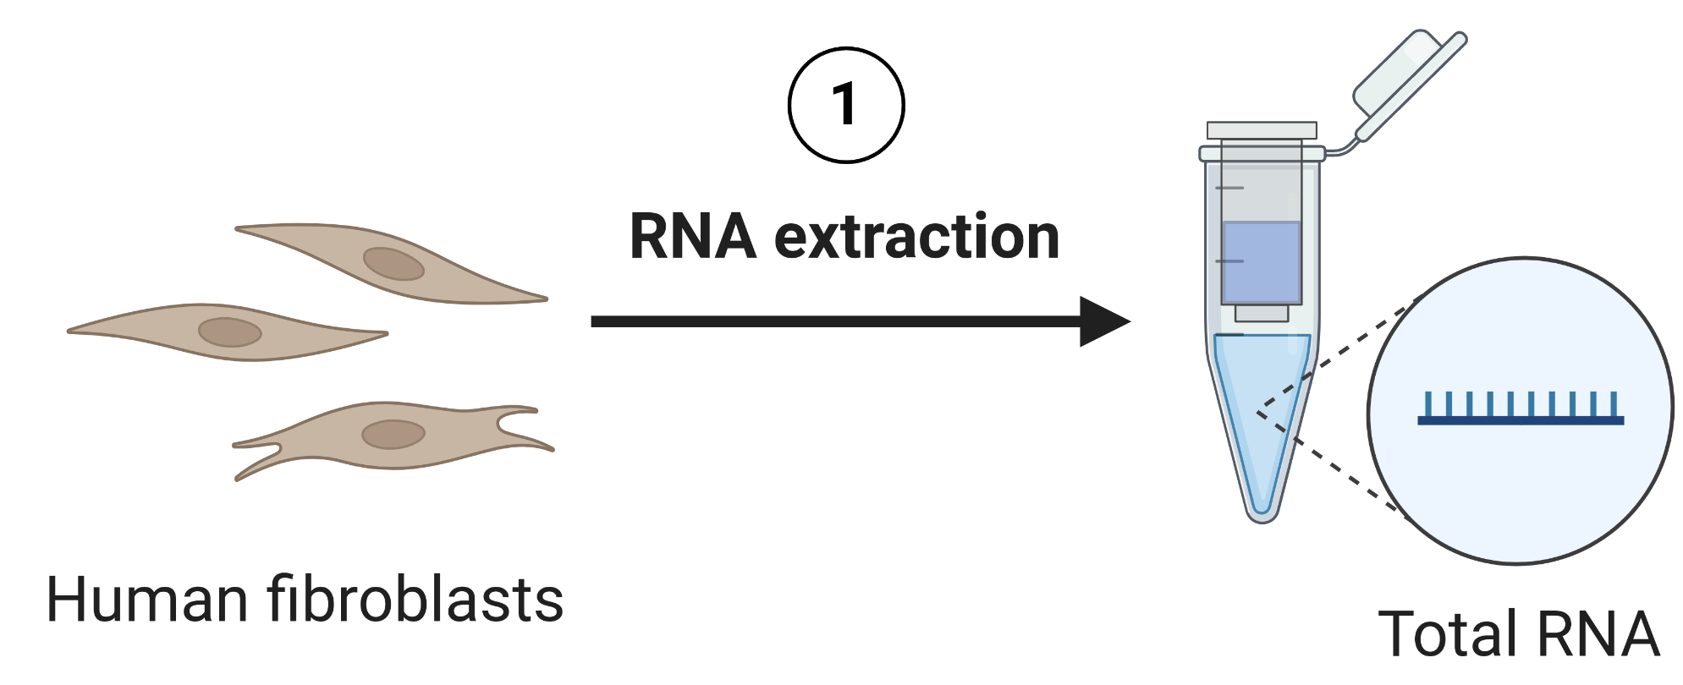

RNA Extraction & Library Prep
Breakdown of RNAs in mammalian cells
rRNAs: ~80-85%
tRNAs: ~10-15%
mRNAs: 1-5%
Other non-coding RNAs (lncRNA, snRNA, miRNA, etc): <2-3%
Library prep methods
Poly(A) selection: Oligo-dT beads capture poly-A transcripts (mature mRNAs)
rRNA depletion: Probes remove rRNA which retains mature mRNA as well as other non-coding RNAs
bioRender

Slide 8
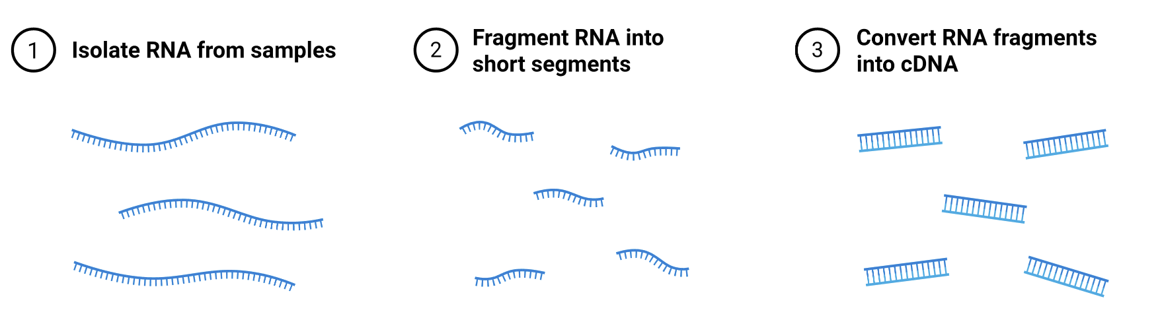
DNA sequencing: Illumina (short read sequencing)
RNA
https://microbenotes.com/illumina-sequencing/

Slide 9
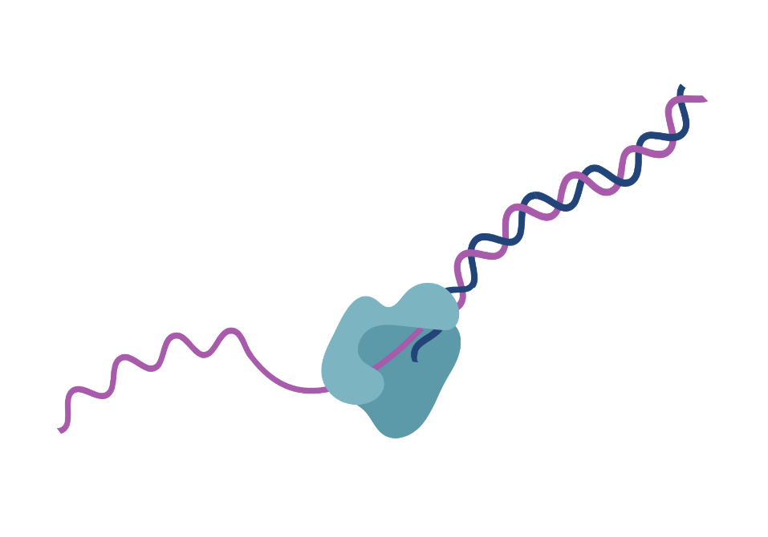
DNA sequencing: Illumina (short read sequencing)
RNA
Reverse transcriptase
https://microbenotes.com/illumina-sequencing/

Slide 10
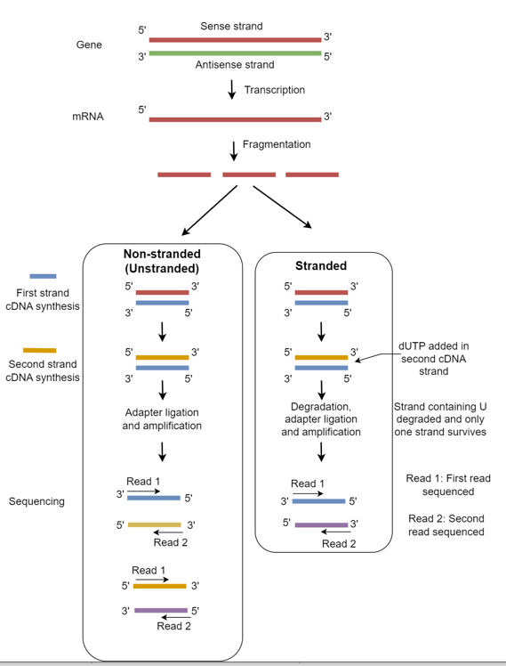
RNA Extraction & Library Prep
Stranded vs unstranded:
Library prep protocol that can provide information on which DNA strand the RNA has been transcribed from
Some genes have overlapping genes encoded on the opposite strand (antisense genes) which can be challenging to resolve without stranded information
Downstream analysis workflows need to know the stranded protocol
https://www.reneshbedre.com/blog/strandedness-in-rnaseq.html

Slide 11
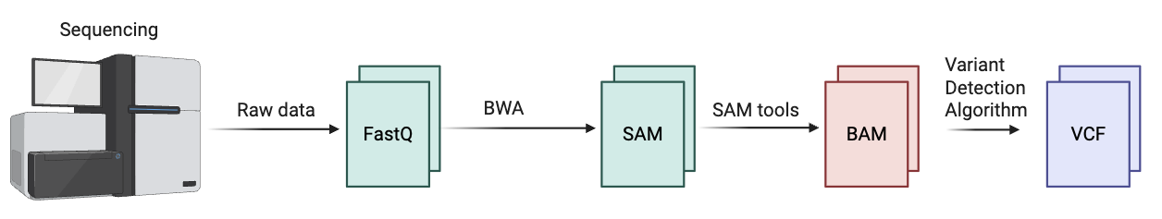
RNA Alignment Pipeline
Requires RNA-specific aligners:
STAR or HiSAT2

Slide 12
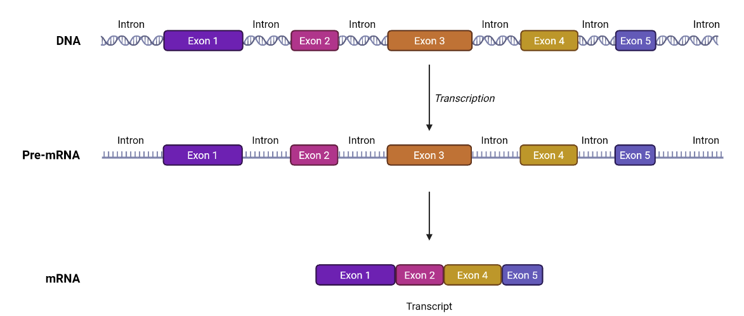
RNA Processing
R1
R2
R1
R2
bioRender

Slide 13
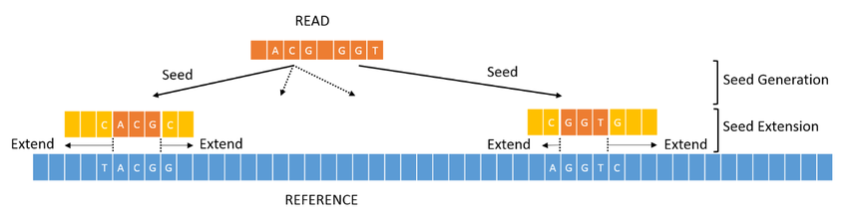
RNA sequencing alignment requires spliced reference genome
Step 0: BWA converts reference genome into compressed index file first
BWA Index
Seeds
bioRender

Slide 14
RNA sequencing alignment requires spliced reference genome
Step 0: HISAT2 converts reference genome into compressed index file while accounting for gene annotations to create splice-aware index
Gene annotations (.gtf)
HISAT2 Index
Few different gene databases:
Gencode
RefSeq
Important to document which database is used and which version
Seeds
bioRender

Slide 15
Motivation: personalized oncology
?
Does the mutation increase or decrease the mRNA abundance of KRAS?
Novel KRAS mutation
KRAS inhibitor
Experimental design:
vs
Novel KRAS mutation (cases)
No KRAS mutation (controls)
Is there a significant difference in mRNA abundance of KRAS and the KRAS signaling pathway between cases and controls? RNA-sequencing
Biorender

Slide 16
RNA Alignment Pipeline
Requires RNA-specific aligners:
STAR or HiSAT2
Most common question from RNA-seq: how many transcripts of a gene is present?
How do we determine that from sequencing data?

Slide 17
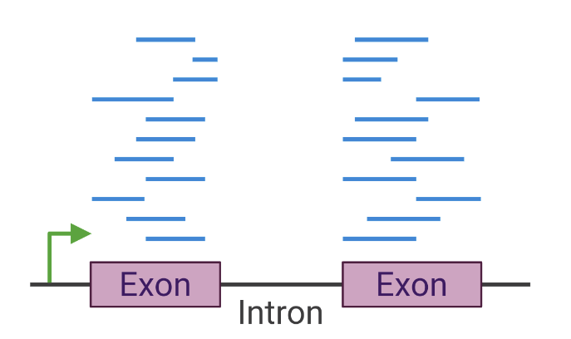
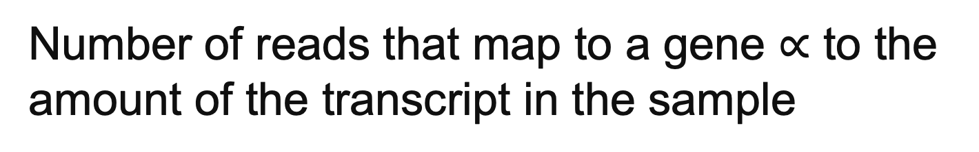
Measuring gene abundance
intron
intron
Number of reads that map to a gene $∝$ to the amount of the transcript in the sample
$$∝$$
The more reads that map to the gene, the more transcripts of that gene present in the sample

Slide 18
RNA Alignment Pipeline
Requires RNA-specific aligners:
STAR or HiSAT2
featureCounts
Read Counts
Needs to known strandedness of library prep

Slide 19
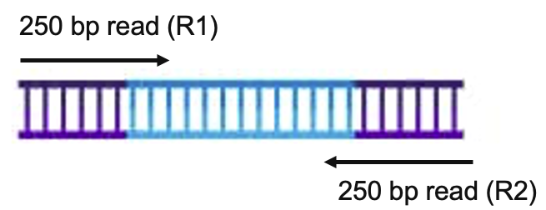
RNA-Seq normalization
It is not enough to just count the number of reads …
1
Mate-pairs
Counting reads will double count the fragments
The more you sequence, the more reads will map to any given gene
10 / 100,000 reads ≠ 10 / 1,000,000 reads
2
Amount of sequencing is not uniform
3
Gene length
Longer genes will have more reads mapping just by chance

Slide 20
Fragments per kilobase of transcript per million mapped reads (FPKM)
FPKM adjusts for all three:
1
Mate-pairs
2
Amount of sequencing is not uniform
3
Gene length
“Fragments”
“Per million mapped reads”
“Per kilobase of transcript”
          11,000,000 RNA-Seq reads generated
          8,300,000 RNA-Seq reads mapped to genome
          783 fragments mapped to CYP19
          CYP19 transcript is 913 bp
          FPKM = 783 / (913/1000) / (8300000 / 1000000) = 103.32

Slide 21
Motivation: personalized oncology
?
Does the mutation increase or decrease the mRNA abundance of KRAS?
Novel KRAS mutation
KRAS inhibitor
Experimental design:
vs
Novel KRAS mutation (cases)
No KRAS mutation (controls)
Is there a significant difference in mRNA abundance of KRAS and the KRAS signaling pathway between cases and controls? RNA-sequencing
Biorender

Slide 22
Hypothesis Testing
Uses sample data to make inference about a larger population
Null Hypothesis: There is no difference in KRAS abundance in cases vs controls
H₀: μ_{cases} = μ_{controls}​
μ_{cases} = the median of KRAS mRNA abundance in cases (individuals with KRAS mutation)
μ_{controls} = the median of KRAS mRNA abundance in controls (individuals without KRAS mutation)
Alternate Hypothesis: There is a difference in KRAS mRNA abundance in cases vs controls
H_{A}: μ_{cases} ≠ μ_{controls}
vs
Novel KRAS mutation (cases)
No KRAS mutation (controls)

Slide 23
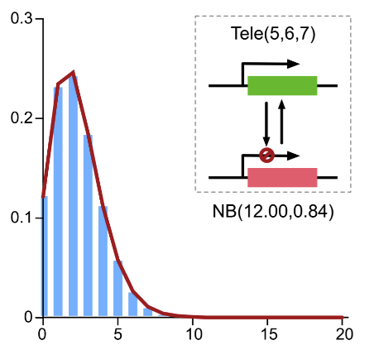
Identifying differentially expressed genes
DESeq2 performs non-linear normalization of RNA-Seq data using the negative binomial distribution & local regression
Normalization algorithm down-plays highly expressed or highly variable genes and thus reduces false discovery, particularly for lowly or highly expressed genes
DESeq2 can perform both normalization and significance tests
RNA-seq data is not normally distributed
density
# of reads

Slide 24
Statistical Significance – Error
 | Null hypothesis is TRUE | Null hypothesis is FALSE
Reject null hypothesis | Type I Error (False positive) | Correct outcome (True positive)
Fail to reject null hypothesis | Correct outcome (True negative) | Type II Error (False negative)
Type I Error:
Controlled by significance level of test (α), e.g. α=0.05
Type II Error:
Related to Power of the test (1 – β) and depends on sample size, effect size and variability

Slide 25
Multiple hypothesis testing correction
RNA-seq analysis often means testing >20,000 genes (based on human genome)
  If we assume 5% error rate, 5%*20,000 = 1,000 genes
Bonferroni (Family-wise error)
Bonferroni is super strict. It tries to make sure the probability of even one false positive among all your tests is very small.
False discovery rate (FDR)
Instead of controlling the chance of any false positive, it controls the expected fraction of false discoveries among the results you call significant.
RNA-sequency studies often instead estimate the false discovery rate (FDR)

Slide 26
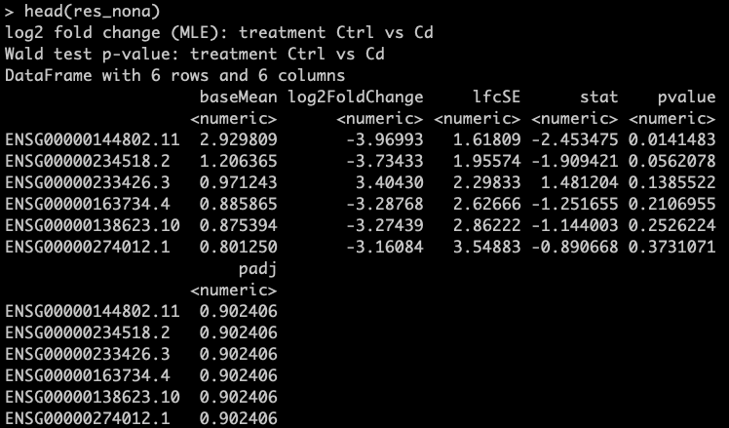
Interpreting results – Output
log2FoldChange: log₂(cases/controls)
Positive value means gene is more abundant in cases
Negative value means gene is more abundant in controls
pvalue: uncorrected p-value for negative binomial regression implemented in DESeq2
padj: FDR adjusted p-value

Slide 27
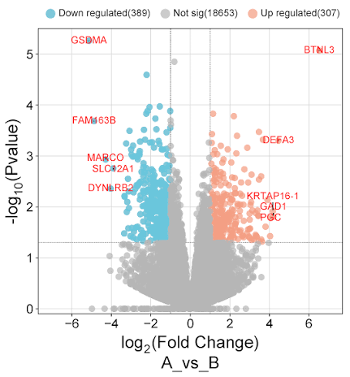
Interpreting results – Visualizations
Volcano Plots: allow for visualization of both effect size (log₂ fold-change) and statistical significance (p_{adj}) at the same time

Slide 28
Interpreting results – Visualizations
Heatmap: allows for visualization of underlying gene abundance for each sample. Can also cluster heatmaps to group together samples or genes that have similar gene abundances
Houlahan et al. Science 2024

Slide 29
Interpreting results – Gene Set Enrichment
I have a list of hundreds of significant genes. What do I do now?
Gene Ontology:
Ontologies are also known as “Controlled Vocabularies” – standardized names and relationships to be used in the description of biological concepts
Ontologies do not contain data but instead are conceptual and map the relationships between concepts
Computer algorithms see ontologies as graphs they can traverse to answer questions about data
The most heavily adopted ontology is the Gene Ontology which represents and groups genes based on Molecular Function, Cellular Component, and Biological Process

Slide 30
CYP1A1 Annotated by Gene Ontology
Gene Ontology represents and groups genes based on Molecular Function, Cellular Component, and Biological Process

Slide 31
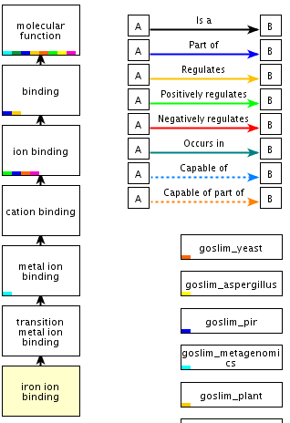
“Iron Ion Binding” Ontological Relationships
Each ontology term is connected to other ontology terms via carefully defined relationship types
“is_a” and “part_of” are the most common relationship types but each ontology may have its own specific types
Tagging data with ontology terms allows researchers to search or classify their data using specific or general terms
Ontologies can help researchers discover unrealized relationships among results

Slide 32
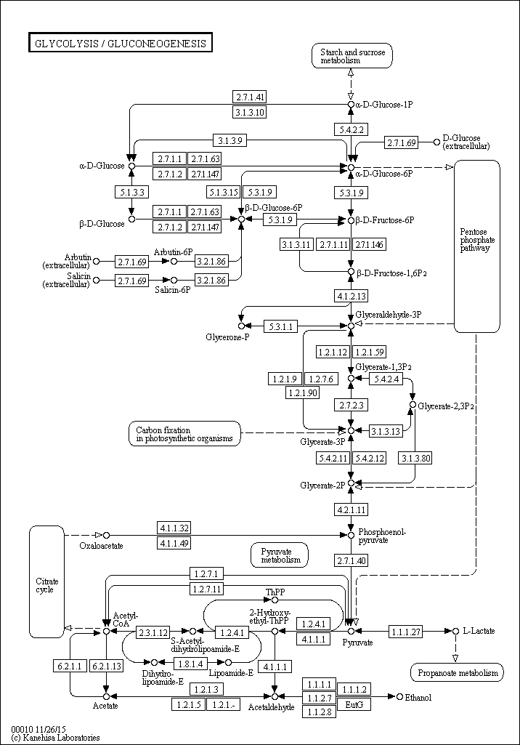
Gene Networks: KEGG
Whereas ontologies map relationships between concepts, networks generally map relationships between real entities that can be measured
Unlike ontologies, networks are generally not hierarchical in nature
The best examples of a familiar network are a biochemical reaction or a regulatory pathway
The most commonly used network resource is the KEGG: Kyoto Encyclopedia of Genes and Genomes
Networks reflect a synthesis of knowledge, particularly around gene regulation and biochemical reactions
Each enzyme or compound “term” is associated with a large volume of curated information on its classification, association with disease, role in the cell, etc.

Slide 33
Interpreting results – Gene Set Enrichment
I have a list of hundreds of significant genes. What do I do now?
Is the overlap greater than expected by chance alone?
Hypergeometric test: statistical test used to determine whether overlap between two sets is statistically greater or lesser than expected by random chance
Significantly abundant genes
Gene network

Slide 34
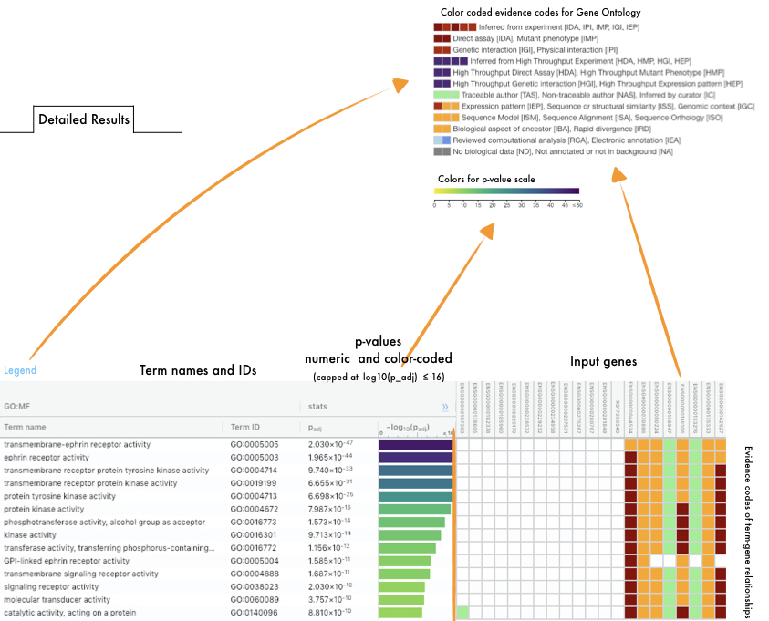
Interpreting results – gProfiler
gProfiler has a database of gene ontologies and networks and will implement hypergeometric testing to compare list of input genes against ontologies/networks
Gene set enrichment analysis provides a starting point
https://biit.cs.ut.ee/gprofiler/page/docs

Slide 35
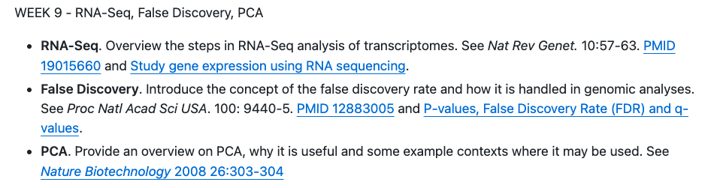
This week …

